Slide 1
Help I Need a Digi-Housekeeper!
Debbie Stubbs & Dee Hennessy (Lancaster University)
Helen Roby & Rebecca Whiting (The Open University)
Gillian Symon & Petros Chamakiotis (Royal Holloway)
Jon Whittle & Ming Ki Chong (Lancaster University)
Jim Ang & Umar Rashid (University of Kent)
Interdisciplinary study, funded by EPSRC (Grant No. EP/K025201/1)
Notes:
In this presentation, we are introducing our research project—the Digital Brain Switch—funded by the EPSRC as part of the Digital Economy stream. The research was conducted by both social scientists and computer scientists from Royal Holloway, University of London; The Open University; Lancaster University; and the University of Kent. Today, we will be presenting some concepts that have emerged from our qualitative analysis in line with the aims of the project, which we are introducing next.

Slide 2
Digital Brain Switch
How do digital technologies affect our ability to manage rapid transitions across work life boundaries?
Three groups of participants: social entrepreneurs (SEs), office workers and students.
Findings based on all three groups.
Illustrations in this talk from the Social Entrepreneur data specifically.
Notes:
The focus of the DBS has been to explore [repeat research question as written above].
Our research has generated some interesting insights into our participants’ management of boundaries between ‘work’ and ‘life’ (and possibly other domains salient to them), as well as the role that technology plays in this. In today’s talk, we will be exploring some concepts that have emerged from our research so far, such as identity issues for SEa, WLB issues, digi-housekeeping, and participant learning from the study.
Our study used three groups of participants: SEs, OWs and students. However, though most findings apply to all three groups, today we will be using illustrations from our SE data.

Slide 3
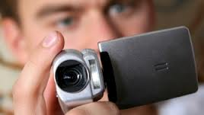
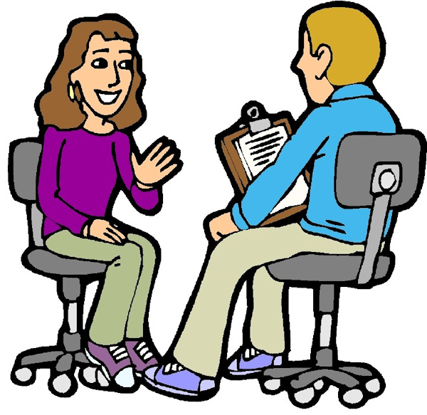
What the participants did
Notes:
45 participants took part in a week’s video study in which they were asked to record instances of transitions between different domains (e.g. work domain vs. social life domain). They decided what was a transition or switch for them and they highlighted the role of technology in these examples. They were then invited to a follow-up interview to discuss excerpts of their recordings and embed these into wider discussions, for example, around their work life balance.

Slide 4
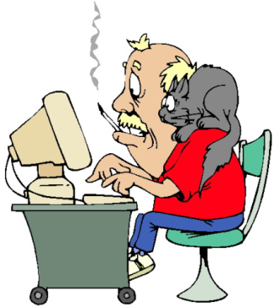
What we have done
Some analysis of the data
Presenting initial ideas
at conferences
Beginning to write papers
Exploring dissemination
ideas
Notes:
We have carried out some analysis of the video and interview data, identifying themes and ideas for further analysis. We have presented some of these ideas at academic conferences and at dissemination events such as today. We are also beginning to write papers for academic journals.
[Since MLR is neither a critical part of the presentation nor are we looking for participants (as opposed to the webinar, which was attended by participants), I suggest we leave it out and just mention it at the end of the ppt. PC]

Slide 5
1st Activity
In discussion with the person next to you:
What does being a SE mean to you?
Does it raise any particular challenges in respect of WLB?
Or not? Does it make it easier?
Notes:
[Debbie: do you think you can improve the content of this slide (and the other three activity slides) to include your instructions (e.g. about how the coloured cards you have suggested will work etc.)? Thanks. PC
I think leave this as the key instructions to the participants which can be displayed whilst they are doing the activity. Further instructions can be given verbally though personally I don’t think there’s much time. Just get them to chat to each other about this. Same goes for the other activities. RW]

Slide 6
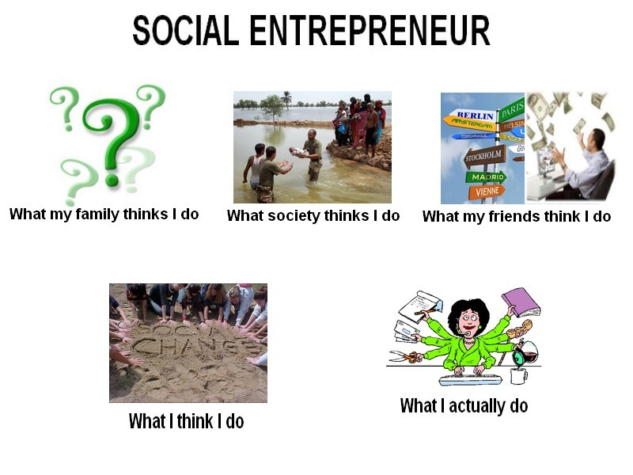
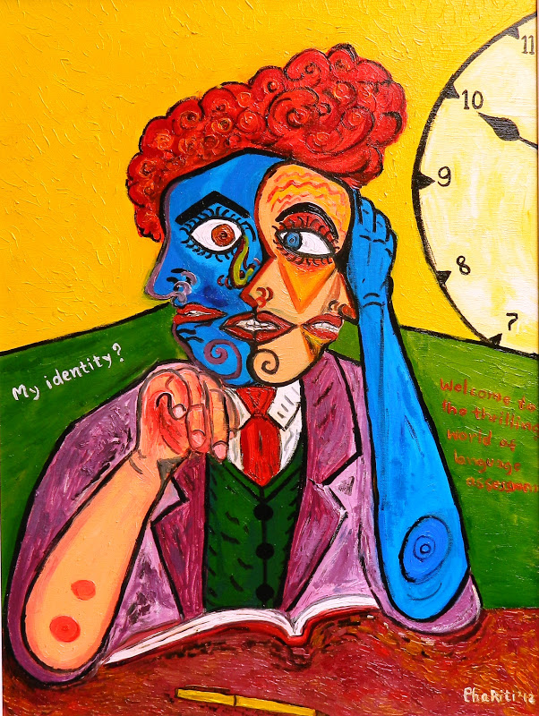
Identity Struggle for SEs
Notes:
We picked up that different groups of contacts, friends and family may have different ideas about what being a social entrepreneur means, and different expectations of you. One of the issues we explore later is how SEs experience these different expectations online.

Slide 7
What being a Social Entrepreneur means to me
“I find with my social enterprise I’m totally me .. My whole SE is set up around what I believe in and my values and all that sort of stuff”
Fiona
“When I worked in the public sector, there was my professional role and my public role and then my private life… I was seduced by keeping those kinds of things separate… now I see that really as quite false … I find that being myself and letting my work and my life merge is leading for me to be more empowered, to be much more honest about who I am and what my life’s all about ”
Stephen
Notes:
In terms of what being a Social Entrepreneurs meant to our participants, we found that they were very closely aligned with their enterprises, seeing them as extensions of themselves. And indeed that moving towards being a SE was an opportunity to escape from potential life/work boundaries….So what therefore did WLB mean for our participants?
[I have changed the second paragraph/sentence here, as it was before since this is based on the data. I have improved the links between the slides too. PC
I have tweaked this again. RW]

Slide 8
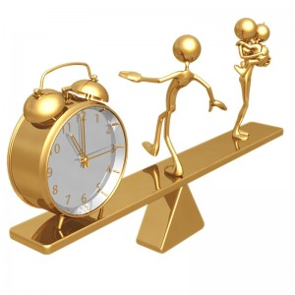
Work, life and balance?
Notes:
One of the concepts we asked participants to reflect on was work-life balance
We start by considering what participants said this means to them – though of course there were some differences in how they experience this, for example, in terms of the role played by technology.

Slide 9
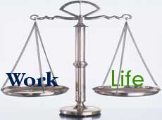
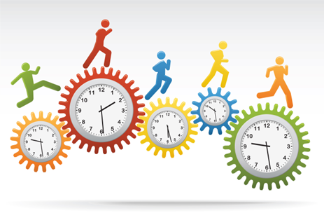
Work - life balance
From talking to participants
it was clear that WLB is
not a fixed idea of how
things should be …
… but a constantly re-negotiated
moving target …
Notes:
We found that work-life balance isn’t a fixed idea of how things should be
Rather it’s a re-negotiated moving target which is constantly managed – we show examples of how we engage in this re-negotiation with ourselves and others. One example is time triage (Carrigan & Duberley, 2013)

Slide 10
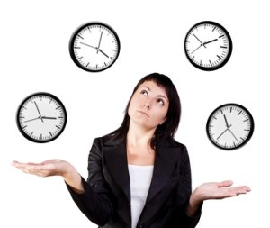
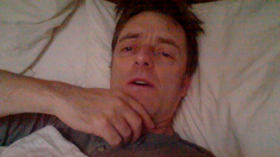
Time triage
‘It’s 7:30 in the morning and I’ve just woken up.... it’s quite a busy day today. I think I’ve got five meetings including that [one] all day, and I want to try to squeeze as much… ‘Ivory Tower’ computer work processing, as I can, as well.’ Michael
Negotiation with self
Notes:
Time triage is a concept borrowed from medics in hospitals and GP surgeries
= When demands from all aspects of our lives exceed the time we have available, we have to decide how to allocate and distribute our time and energy resources across these competing priorities
In doing so, some of these demands will be met immediately, some later, some not at all
‘It’s 7:30 in the morning and I’ve just woken up.... it’s quite a busy day today. I think I’ve got five meetings including that [one] all day, and I want to try to squeeze as much… ‘Ivory Tower’ computer work processing, as I can, as well.’ (Michael, SE, video 047)
This example illustrates how we might start the day trying to get to grips with what we have to do and we might well feel we have it and our priorities all sorted out - but as the day goes on we are constantly re-negotiating as we come up against other people’s schedules, demands and problems

Slide 11
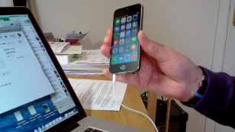
Re-negotiation during the day
‘Okay, it’s ten past three and nothing ever goes according to plan. So the two o’clock phone call happened okay, but then I’ve got interrupted with a different phone call coming in that’s unexpected… And my three thirty appointment asked could they ring at three. They’ve not phoned at three. I don’t think I’ve missed them. I’ve just been checking.’ Stephen
Demands of others
Notes:
Time triage – this negotiation with ourselves and others – is constantly performed and renegotiated throughout the day
We find we have to work around other people’s work routines and priorities
‘Okay, it’s ten past three and nothing ever goes according to plan. So the two o’clock phone call happened okay, but then I’ve got interrupted with a different phone call coming in that’s unexpected… And my three thirty appointment asked could they ring at three. They’ve not phoned at three. I don’t think I’ve missed them. I’ve just been checking.’ (Stephen, SE, video 008)
This highlights how our plans about how we allocate our time and the switches or transitions we make during the day (within and between work and other roles) are not always in our control but are subject to the demands of others. WLB is not (just) a matter of flexibility or having personal control of time. We now look at ways in which rationalise to ourselves about working at times and for periods that we might not have originally planned. We suggest that these might be useful concepts to help us reflect on our work practices.

Slide 12
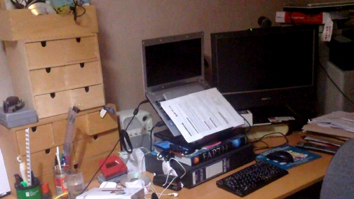
‘Working Lightly’
“I've just put the kids to bed, it's Friday evening about 8 o'clock and I'm just coming in [to the home office] to make a couple of notes about things I've got to do next week, I don't want to forget before the weekend.”
David
‘I suppose I would view Twitter and Facebook, for my work, as leisure time, I suppose. It doesn’t seem like work to me.’
Rachel
Rationalising to self
Notes:
Another concept we can look at as part of the daily re-negotiation with ourselves is ‘working lightly’
This refers to how we making over-working – or working long hours - feel better (Bourne & Forman 2014)
= Rationalising that time we spend working at the weekend or in the evening makes us feel better and more prepared
“I've just put the kids to bed, it's Friday evening about 8 o'clock and I'm just coming in [to home office] to make a couple of notes about things I've got to do, er, next week, I don't want to forget before the weekend.” David, social entrepreneur, video 005
Or conceptualising aspects of work as leisure: ‘I suppose I would view Twitter and facebook. For my work, as leisure time, I suppose. It doesn’t seem like work to me’. (Rachel)

Slide 13
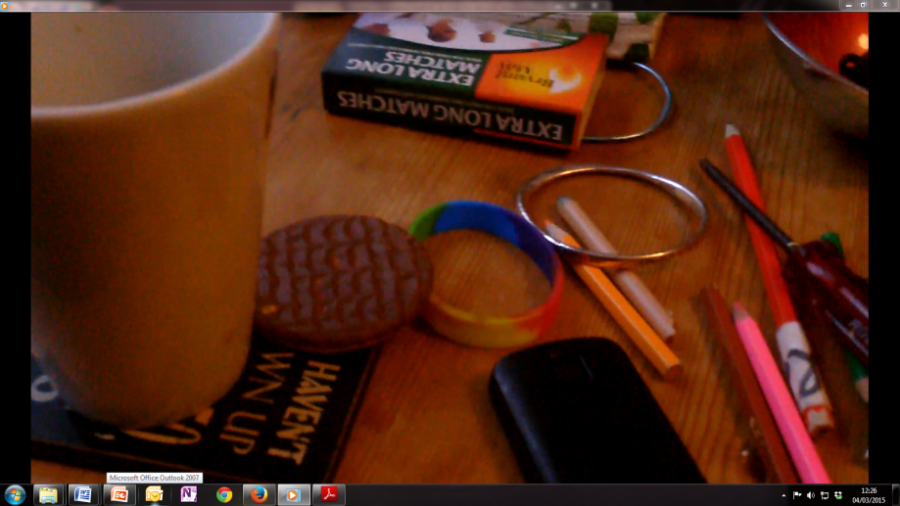
'Working Lite’
‘
It’s three p.m. on Wednesday. Back from shopping. My daughter’s on my computer in the office doing her homework for school tomorrow. I’m completely shattered still. So I’ve got a coffee and a chocolate biscuit and just sitting in the armchair with my iPad just catching up, trying to not feel quite so tired.’ Jane
Making it not feel like work
Notes:
Another concept from the same researchers that we can look at as part of the daily re-negotiation with ourselves is ‘working lite’
This refers to how we make work feel not like work (Bourne & Forman 2014)
= Adopting a leisure activity such as sitting down with a coffee and biscuit in an armchair whilst working to make it feel less like part of the working day
‘It’s three p.m. on Wednesday. Back from shopping. My daughter’s on my computer in the office doing her homework for school tomorrow. I’m completely shattered still. So I’ve got a coffee and a chocolate biscuit and just sitting in the armchair with my iPad just catching up, trying to not feel quite so tired.’ (Jane, Social Entrepreneur, video 045)

Slide 14
2nd Activity
What have you learned from this section of the presentation?
Who works lightly and who works lite?
Are these helpful ways of reflecting on how you work and / or on issues of WLB that you might face?

Slide 15
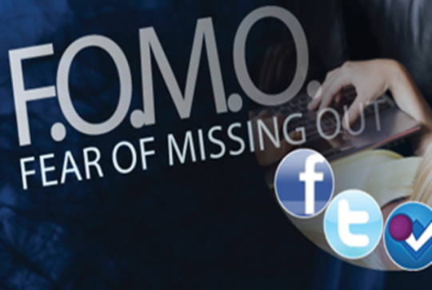
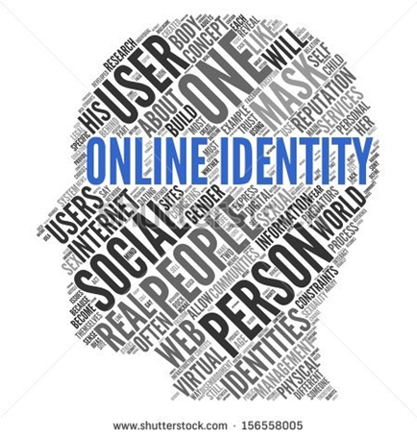
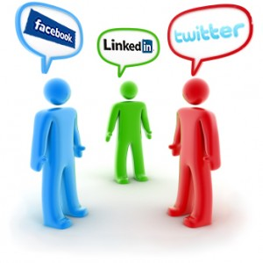
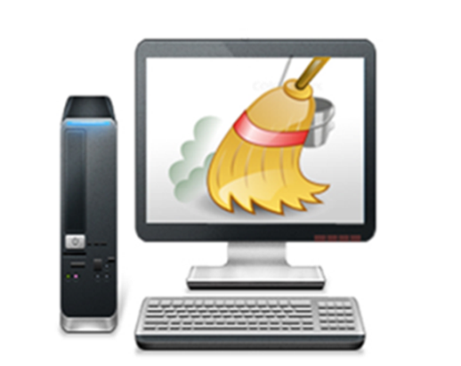
The flip side of being flexible
Notes:
Flexible working is often suggested to be a means of achieving a better WLB – and for some SEs an important part of how they work
Many of our participants told us that they – but also those they work with and for – have a degree of flexibility in terms of how they are able to work
This might be the ability to work anytime anywhere including working from home [I have tweaked this a bit for this audience, RW]. This is often presented in the media as a ‘good thing’ and for some people it is. However, there are costs associated with this flexibility. Here we examine some of those costs.
A lot of the potential downsides of flexible working come from constant connectivity. This creates an online identity that has to be managed.
For example, we feel we need to manage:
the expectation of others that we are always available to deal with emails etc
the impression we give if we don’t respond to emails
our worry that we will be missing out if we’re not connected (this is sometimes referred to as FoMO, fear of missing out)
the tasks that allow us to be and remain connected

Slide 16
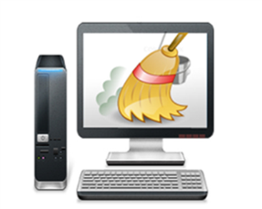
What is Digi-Housekeeping?
Work performed by individuals to support and maintain their use of modern communication technologies
Particularly work required to sustain ‘being online’ across all aspects of work and life
Often carried out in pursuit of different forms of ‘flexible’ working
Challenges traditional binary domains of ‘work’ and ‘life’
And is largely hidden and unpaid
Notes:
Flexible working is largely sustained by mobile communication technology which allows us to work anywhere any time
But the devices and applications we use to enable this also create a whole raft of additional tasks, eg when email accounts don’t sync across devices
Additionally the use of social media provides its own impetus such that we now feel we have to service various on-line identities on a continuing basis and to keep checking for information in case we are missing out…
We call these activities digi-housekeeping – and it doesn’t neatly classify as ‘work’ or ‘life’ as in the concept of WLB

Slide 17
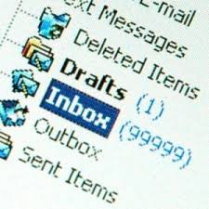
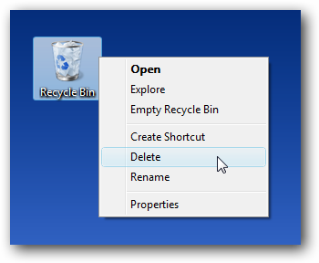
Digi-Housekeeping: Clearing & organising
‘When I come into my work email this is when I have to do most of it. And this is just annoying and a waste of time. I just have to go through and delete 34 emails. Most of it is just junk, kind of annoying, most of the time but there you go.’ Jane
‘as soon as I got into the Eurostar, I got my laptop out and just kind of juggled between work, emails, sorting out files on my desktop, cleaning up a bit on my desktop, clearing my bins, my folders, rearranging things and I came up with about twenty-five different sort of ideas and little business ideas I could do also for coaching business’ Mark
Notes:
These examples illustrate different aspects of digi-housekeeping. It is the technological equivalent of keeping junk out of places where we live and work - or setting up storage and filing systems to keep things organized. Some tasks are seen as similar to domestic housekeeping – as Mark’s example here says ‘clearing my bins’ and in another example, a participant uses the domestic analogy of comparing answering emails with sweeping up leaves.

Slide 18
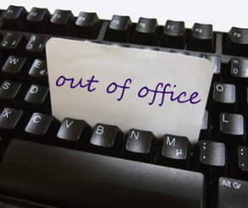
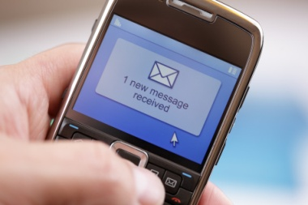
Digi-housekeeping: Managing expectations
“when I'm back at home and I'm thinking: ‘oh, now I've got to rush and I've got to finish things, because I need to go to school’. And then when I come back, and I think, now I want to spend time on my son, but I've still got emails coming through, and I need to check my emails; or I need to respond to texts, and I feel I need to do that because everyone else is still working.”
Fiona
“I won’t be doing that, because I’ll still be checking the emails, the impression I’ve tried to create, is that I would not respond to them… Because people expect you to respond instantly. And that’s my own fault, because I do, a lot of the time.”
Rachel
Notes:
For all our participants, not just SEs, an online presence was accompanied by the need to manage the creation of expectation that we will respond to emails immediately whatever time it is
But this means we then need to take steps to re-negotiate this expectation which we find difficult
Like setting out of office messages but then replying to emails anyway. Or feeling under pressure to respond to emails or texts because it’s a time of day in which we think others are working.
We then worry about what people will think when we don’t reply

Slide 19
Digi-housekeeping: Supporting online presence
“I use FB for myself personally and also for [my social enterprise]. It’s just a way of updating people as to what [the SE] is doing. To make sure that they know that we’re constantly doing things, and to keep the profile raised”
Rachel
“Some .. SEs .. use social media quite a lot .. promoting themselves on it…. [I’m] quite limited in terms of what I can actually do [because of family] .. When you spend time looking at those things … it gives me some anxiety because I’m looking at it and saying ‘wow he’s doing that and that’s interesting’ … why am I not doing that?”
David
Notes:
These digi-housekeeping tasks are mostly unremunerated (like other forms of digital labour) but are seen by SEs as an essential part of enabling remunerated work and often as enabling flexible working patterns.
Other digi-housekeeping tasks for SEs – as illustrated here - are to support an online identity for the social enterprise.
We observed how this created for some an ongoing sense of obligation to keep posting material on social media. As with other digi housekeeping tasks these aren’t easily classified as work or non work. As we now explore, this raised the issue of boundaries for SE participants.

Slide 20
If being a SE is your life where are the boundaries online?
“Twitter is all about how clever you are in a public forum and I’ve realised how private I am about my use of technology and sharing... It’s a terrible pressure to use it all the time to say ‘look at me, look how clever I am’ ”
Cressida
“… one of the members [of the cooperative] left and started a really acrimonious campaign against the other people who were left online …….. it made me quite sensitive to the fact that I can post something that [might later be painted] in a bad light … I don’t mind doing it to some extent with work but I don’t like the thought of putting out a lot of personal information.. just in case it is used by someone against me at some point in the future”
David
I created a fake FB profile and I tried to separate [life and work]. But I’ve actually abandoned that… I am me. And so on FB I have my face there. And I protect my FB profile, I don’t show every behaviour to the public world, I don’t show my friends. If I’m to kind of try to manage the privacy of it.
Jez
Notes:
For social entrepreneurs in particular, the unity of self and business implied by being a Social Entrepreneur and the supposed open-ness of social media leads to some real issues of identity struggle for some SEs – wanting to be themselves but aware of the impression this makes on-line and to some struggles about how much of self to present. This concern illustrates that being a SE is not necessarily the freedom from boundaries and the increased flexibility expected and indeed that the boundary that might be of most importance to SEs is not between work and life but between the private and the public.

Slide 21
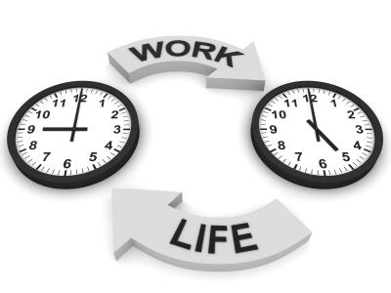
Summary: Beyond work & life?
Think about work life balance as a series of negotiations with both ourselves and others
Are ‘time triage’, ‘working lightly’ and ‘working lite’ useful tools for reflection on our work practices?
Reflect that there may be an online domain that spans both work and life
Notes:
To summarise, we suggest that it might be useful to:
think about work life balance as a series of negotiations with both ourselves and others
reflect that there may be an online domain that spans both work and life, which creates new opportunities but also new tasks and roles like digi-housekeeping and keeping an active social media presence
consider how this can be managed – are the ideas of time triage, working lightly and working lite useful tools for reflection on our work practices?

Slide 22
3rd Activity
Do you recognize the concept of digi-housekeeping from your life?
How much digi-housekeeping do you do and what sort of tasks does it involve?
Does it create any particular challenges?
Are there things that would make this easier for you?

Slide 23
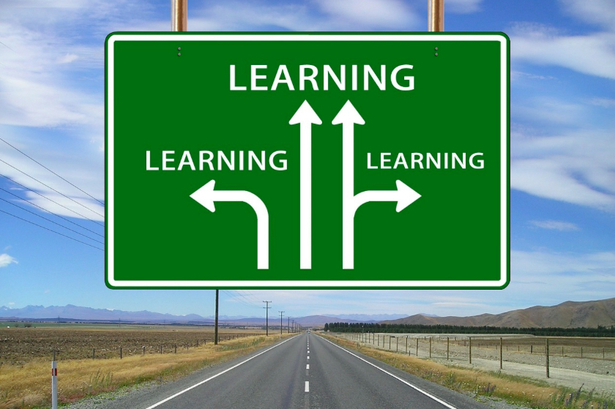
Learning from taking part

Slide 24
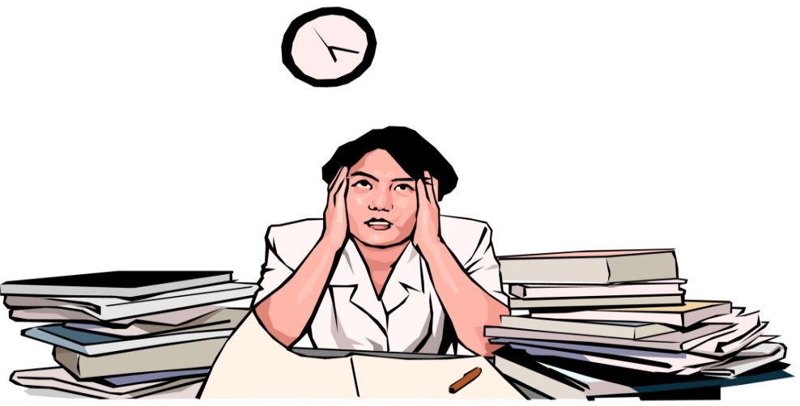
Learning something new about yourself
“It made me very, very conscious that week of what a chaotic life I lead, and I don’t really like chaos at all, it’s not my thing. And it made me very conscious of how frustrated I got with really silly little things.. On one occasion I was emptying the washing machine, I was so pissed off that I was emptying the washing machine!” Fiona
“It made me appreciate how I can do very long hours sitting in front of a computer. Thinking that I am being engaged with the world but really just sitting statically in a space […] observing how punishing my digital life is sometimes… So I came away with a good impression of the fact that I care a lot but sometimes I get too enwrapped in it and it’s okay to step back !” Jez

Slide 25
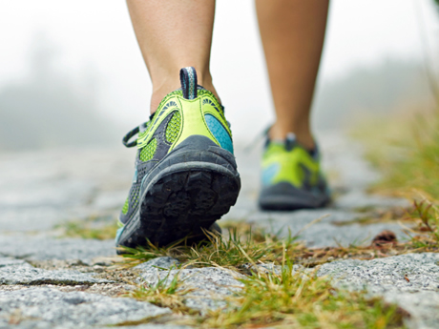
Realising and Appreciating Current Activities
“Well, yes, about the routines that I’d established that I didn’t know I had. That was definitely one thing […] even though I’ve said about the journey being a buffer, you’re right, I’ve already checked my emails, and as soon as I get in I’d probably do that as well. [Also] when I get to work I’m going in to get a coffee. And I didn’t realise I had so many [routines].”
Denise
Realising one’s routines

Slide 26
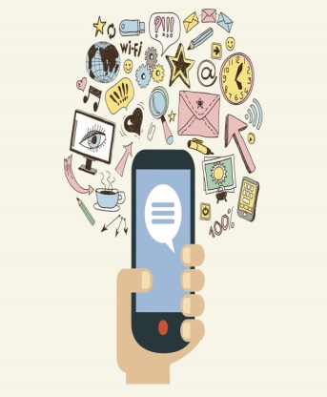
Changing Behaviours
“One thing I did do, I turned off the Buzzy Twitter account notifications on my phone, while I was doing the diary, because I realised they were going off all hours ...”
Anna
“Getting through that week [of videoing] was quite a challenge for me, because I knew I could have to discuss my inner-outer world with other people, and I thought, if I can do that, maybe I can do Twitter… You’ve started a process in me which is more about sane engagement with technology rather than insane engagement with technology”
Cressida
“I started reducing the things that I felt are not 100% effective, not necessarily important to me, nor important to the business.”
Allan
Engaging with social media
Becoming more efficient
Managing interruptions

Slide 27
4th Activity
How are others putting what they have learnt to improve their practice?
What areas do you struggle with or would like to learn something new about?
What do you think you could or would do differently after this talk?

Slide 29
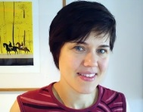
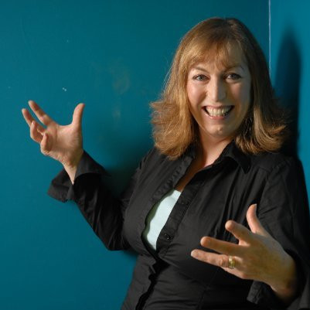
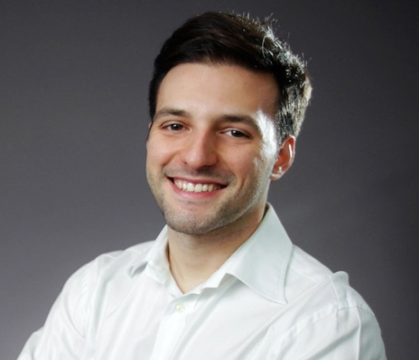
Open questions and feedback
Rebecca Whiting
Debbie Stubbs
Gillian Symon
Dee Hennessy
Petros Chamakiotis
Notes:
I have increased the size of the pics because they were not clear earlier. I have separated Debbie and Dee as they are attending F2F from us who are attending virtually for better presentation. Debbie: do we have a picture of Dee? PC

